Slide 1
Stochastic Modelling of Oil and Gas Economics 2018 Industrial Problem Solving Workshop Michael Morgan – GLJ Petroleum Consultants

Slide 2
Who We Are and What we Do
Our core competency is to independently evaluate, from the well on up, how much oil and gas E&P companies own, how this will likely be extracted and how much money this is worth.
We are one of the largest petroleum evaluation firms in the world
Our evaluations cover companies that range in size from startups with five employees to the largest independents and cover every type of oil or gas play from offshore conventional, to tertiary recovery, to SAGD to multi-frac’d unconventional.
Our evaluations are used for mergers, acquisitions, stock market filings, pipeline supply studies and other key investment decisions
With approximately 100 employees, many of them with decades of experience within the firm, we can analyze multi-billion dollar assets within weeks, often with little notice.
We were established 1972 and are located in Calgary, Alberta; that’s our home turf, but we analyze companies and assets that span the world.

Slide 3
How our work is changing
Development of oil and gas resources used to entail drilling a relatively small number of wells into potential oil or gas “traps”. These traps might not contain hydrocarbons.
Drilling was economically risky, but the traps had clear limits and properties that could be determined with reasonable certainty once the wells were drilled.
In both Canada and the US, these types of opportunities have already been exploited. Development is shifting to low-grade regionally extensive oil and gas deposits.
Drilling “dry holes” is less likely, but requires a large number of wells over a large number of years in oil and gas pools with poorly defined limits and uncertain but correlated properties.
Let’s look at an example of what is being developed and current analysis techniques…

Slide 4
The Montney is Becoming Canada’s Main Gas Supply
It is the largest (and growing) supply for gas in British Columbia
British Columbia is becoming a larger fraction of Canada’s gas supply
Montney
British Columbia

Slide 5
The Montney is Becoming Canada’s Main Gas Supply
The overall result is that, over ten years, the Montney is now responsible for about a third of Canada’s gas supply
BC Montney
Alberta Montney

Slide 6
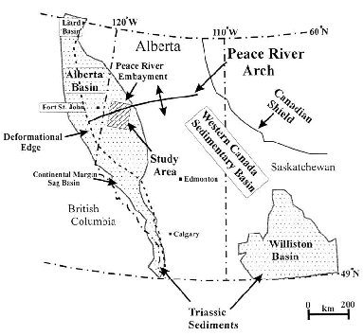

Extent of WCSB Triassic Sediments
Toad River
Canmore
Panek 2000

Slide 7
Billions and Billions of Dollars are Transacted
Seven Generations IPO
$0.93 Billion
Petronas buys Progress
$5.50 Billion
Mitsubishi/EnCana JV
$2.90 Billion
Tourmaline IPO
$0.23 Billion
Shell buys Duvernay Oil
$5.9 Billion
Arc Resources buys Star Oil and Gas in 2003
$0.71 Billion

Slide 8
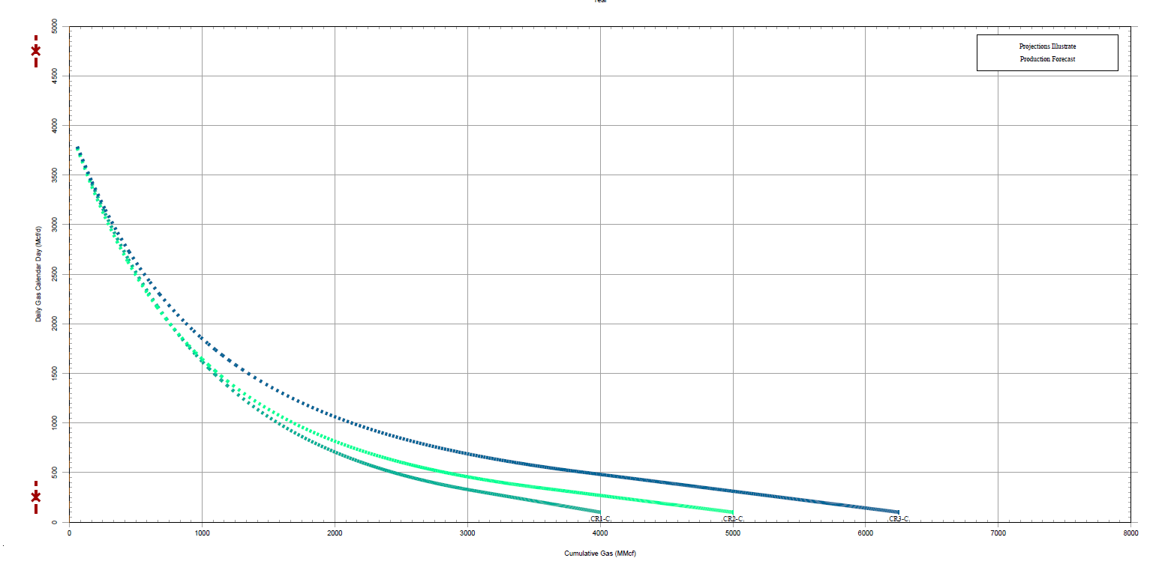
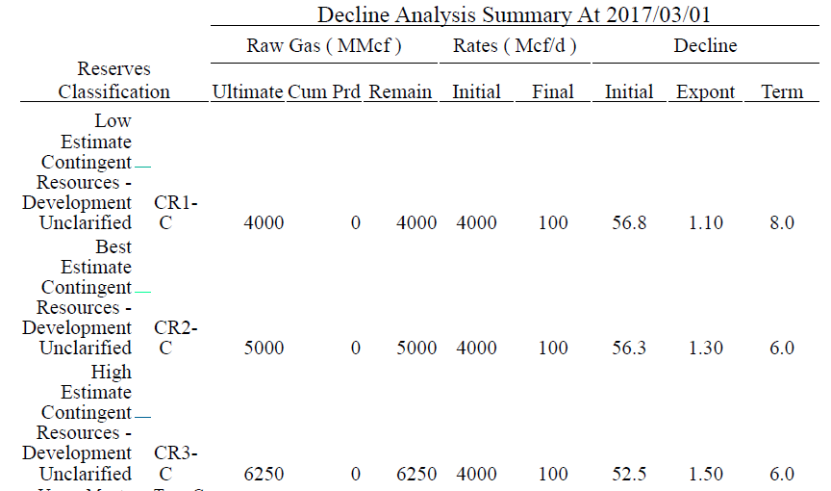
Wells are Forecast using “TYPE CURVEs”
Based on existing Groundbirch wells and nearby Pengrowth, Shell and Crew West Septimus Upper Montney wells. 2500m horizontal length well and 10 wells per section (1205 wells in Groundbirch).

Slide 9
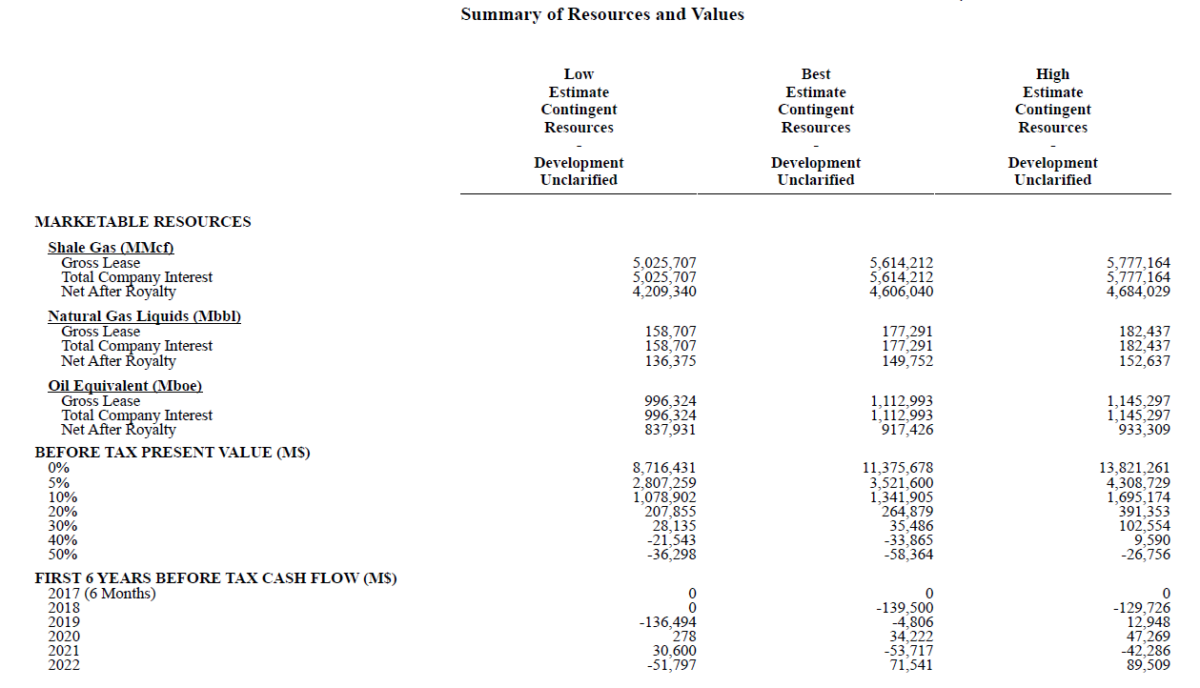
ECONOMIC Analysis is Conducted using Discounted Cash Flows

Slide 10
Economic Returns are Dominated by Commodity Prices
ROR ~35%

Slide 11
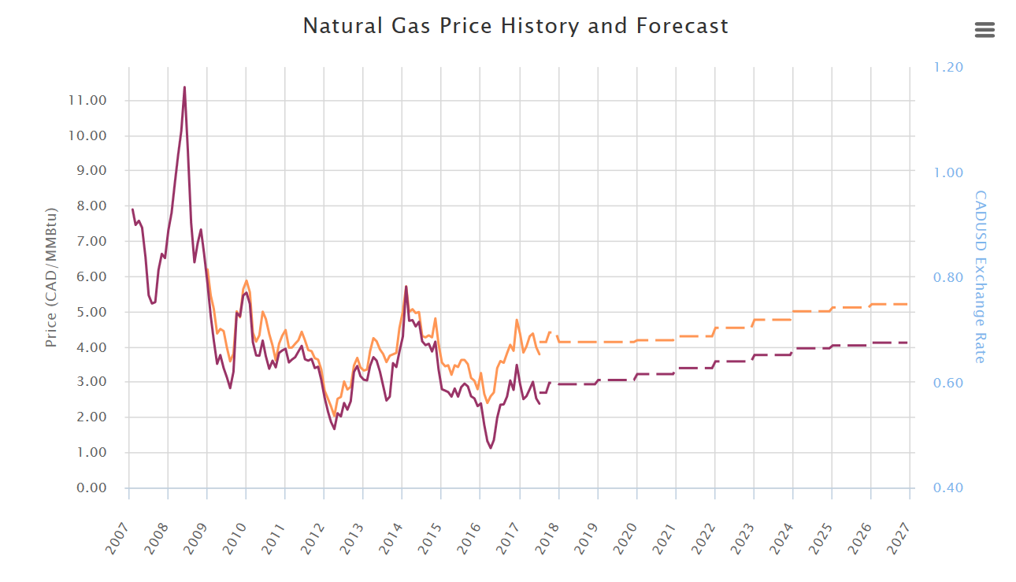
Deterministic forecasts are Used for Commodity Prices
Based on GLJ AECO price forecast and 1100btu/scf heating value
HENRY HUB
AECO

Slide 12
Rate of Return
Notes:
Roughly $30 oil

Slide 13
Economic Risk Analysis often Reverts to Simple Price Matrices
We could reproduce Seven Generation’s reported economics: they have a good rates of return if oil prices stay at CAN$50/bbl
Returns are not as robust as some other areas if oil is $30/bbl
The tables below show simplified single-well economic runs

Slide 14
analysis We Think Industry Will Need in the Future
As more and more of industry’s workload shifts to resource play development it will become more interested in the mechanics of how uncertainty is treated. For example, using a simple “rule of thumb” 15 or 20% spread between forecasts may not suffice, nor will ignoring correlations between well results when doing statistical aggregation.
The problems I submitted all address methods of generating probabilistic forecasts, whether for pipeline supply studies, price decks, production profiles or the economics of constructing deep-cut facilities.
In this project, we are interested four different general areas:
Econometrics
Real Options Analysis
Geographic Correlation and Temporal Uncertainty
SDE Solutions to PDEs
Stochastic models provide an approach to these problems by treating certain unknown parameters as random variables and performing an in-depth analysis that takes into account this uncertainty. In particular, stochastic differential equations (SDEs) are one useful method whose application are of interest to oil and gas economic problems.

Slide 15
1) Econometrics
Most econometric analysis has used price series external to Canada such as the price of West Texas Intermediate (WTI) oil or of gas traded at Henry Hub. However, Canadian producers most often receive revenues based on the price of oil at various refineries in Edmonton or on the price of gas at either the AECO trading hub or at Station 2 in British Columbia.
Current practice often models Canadian prices to be simple linear functions of world benchmark prices. However, such models do not allow different mean reversion rates, volatilities or correlations, all of which may be necessary to reflect fundamental physical and economic differences specific to the Canadian market.
A successful solution would propose an analytical framework suited to the observed dynamics of Canadian energy commodity prices; statistical work supporting the inclusion or exclusion of various factors or terms; calculation of best estimate parameters; forecasts showing equi-probable future outcomes and any computer code required for these calculations.
Data for various Canadian price series can be provided by GLJ Publications.

Slide 16
A Sample Single-Commodity Model
Real prices don’t increase without limit.
Instead, they appear to drift back to normal after any dramatic change (up or down).
An Ornstein-Uhlenbeck Model captures the basics of this behaviour.
Change in Price
Difference from Average
Error
How Fast
How Variable

Slide 17
Model Parameters (Real Prices $CDN)
 | Average | Volatility | Half-Life
WTI Brent Edmonton Light Sweet Edmonton Condensate Edmonton Mixed Sweet Cromer Light Hardisty Heavy Edmonton Butane Edmonton Propane Henry Hub AECO Alberta Plantgate Station 2 | 87.04 92.07 85.13 90.71 84.58 80.49 55.48 69.93 53.29 4.77 4.78 4.53 4.66 | 29.91% 27.22% 35.09% 30.76% 35.17% 37.46% 78.24% 37.76% 41.04% 47.88% 47.43% 48.90% 50.76% | 1.334 1.029 1.442 1.140 1.434 1.513 2.654 2.043 2.353 0.425 0.576 0.567 0.644
Since 2005, the less you are like Brent or AECO/HH,
the lower and the more volatile your price.

Slide 18
2) SDE Solutions to PDEs
Simple PDE production models are commonly used for economic calculations, especially PDEs with compact analytical solutions. For example, late life wells produced with a constant pressure are often modelled using a simple exponential relationship, dq/dt = -Dq where q is the flow rate and D is a constant rate of decline. The parameters of these models cannot be precisely determined a priori, nor can they be estimated with precision due to the difficulty in precisely controlling producing conditions for accurate flow measurements. As such, forecasts are uncertain.
Our goal here is to model the parameters as stochastic processes and solve the resulting stochastic differential equations using Ito's Lemma. These can then be used to compare with data from actual wells to evaluate how well these stochastic models are working.
Common PDEs used to forecast production include the following:
Arps:
dq/dt = -(D₁/q₁^{b}) q^{b+1}
Power Law Exponential:
dq/dt = -( D∞ + D₁t^{-(1-n)}) q
Stretched Exponential:
dq/dt = -(n/t) (t/τ)^{n} q
Logistic Growth:
dq/dt = -{a-an+(1+n)t^{n}}/{t(a+t^{n})} q
Duong:
dq/dt = -(mt⁻¹-at^{-m}) q
A successful solution would propose analytical stochastic solutions to a selection of the common PDEs models; calculation of best estimate parameters; forecasts showing equi-probable future production outcomes; forecasts showing the distribution of expected future revenues and any computer code required for these calculations.
Historical production data and typical economic parameters, including royalty models, can be provided by GLJ Petroleum Consultants.

Slide 19
Simple Production Forecast: The Short Version
This complex production behavior is approximated by the use of a two stage Arps decline
Stage one is a super-harmonic decline with an “n” exponent that is commonly set equal to 1.4
Stage two is an exponential decline
We continuously examine the validity of this model

Slide 20
Rigorous Decline Parameter Distributions
We are looking to also rigorously calculate the confidence interval (at the well level) for the model parameters
With increasing production, models start converging to sensible best-fit parameters
Here be Dragons! With little production history, most any model can be fit to the data, even models with farcical inputs

Slide 21
3) Geographic Correlation and Temporal Uncertainty
Nearly all energy resources are aggregated using fixed infrastructure. However, energy supplies are nearly always spatially correlated and have a temporal quality. Good wells are clustered together and they produce at decline rates. Wise investment decisions on fixed infrastructure will need to consider both spatial and temporal patterns.
It would be beneficial to have a model for pipeline supply that considers a catchment area within which discrete input sources are located (ie gas wells). These input sources are not constant: they decline over time according to uncertain spatially correlated parameters. Such a model should calculate the distribution of number of point sources required, and the pace of adding them, to maintain a constant supply to the pipeline. Such a model should also consider how the distribution changes with increasing certainty, both in terms of the underlying (spatially varying) productivity of the area and in terms of the uncertainty of the decline parameters.
Such a model for pipeline supply would be beneficial when considering development within relatively untested areas, thereby better informing investment decisions and development strategies.
Monte-Carlo methods have been employed, but convergence can be slow and the correlation structures hard to state compactly.
A successful solution would propose an analytical framework; statistical work supporting the choice of spatial and temporal models; forecasts of various development scenarios, the distribution of point sources required to maintain a constant supply and the impact of certainty of model parameters on this distribution; and any computer code required for these calculations.
Historical data for various catchment areas can be provided by GLJ Petroleum Consultants.

Slide 22
Regional Trends: Well Productivity
Normalized peak gas rate per 100T frac equivalent.
This does not account for produced liquids.
Notes:
ADD CATCHMENT AREAS.

Slide 23
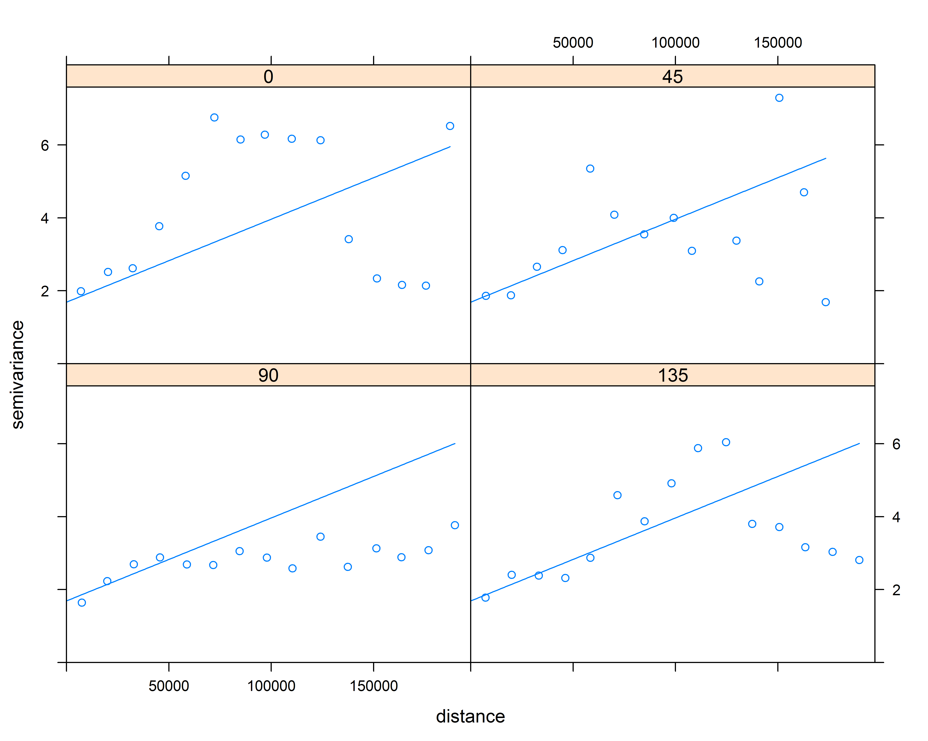
Montney Variograms

Slide 24
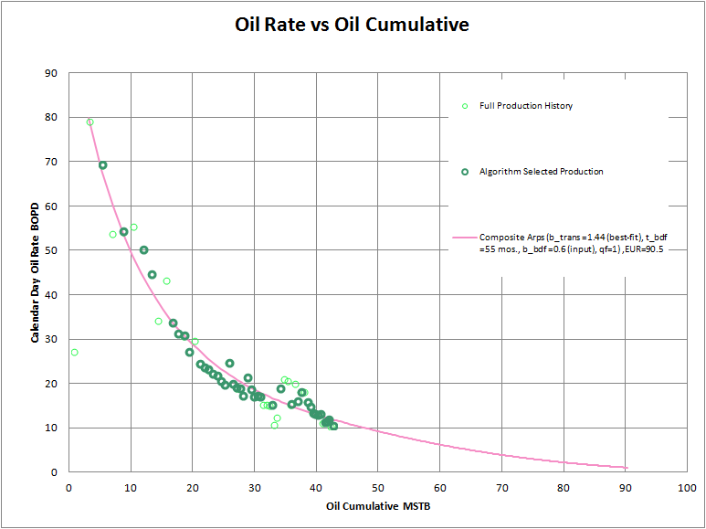
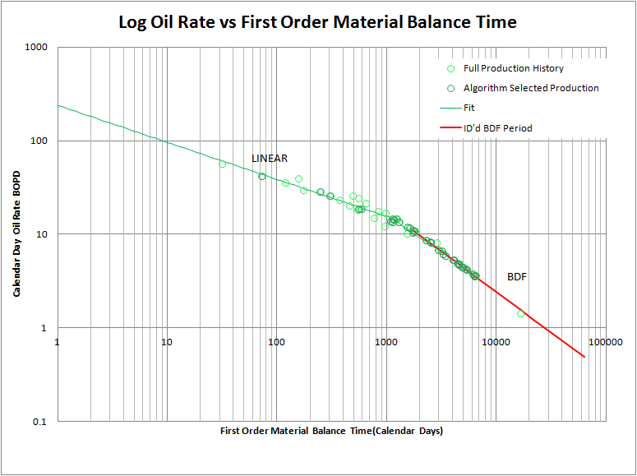
Production forecasts
Two-stage Arps hyperbolic declines
Bootstrap resampling
Consideration of physical system

Slide 25
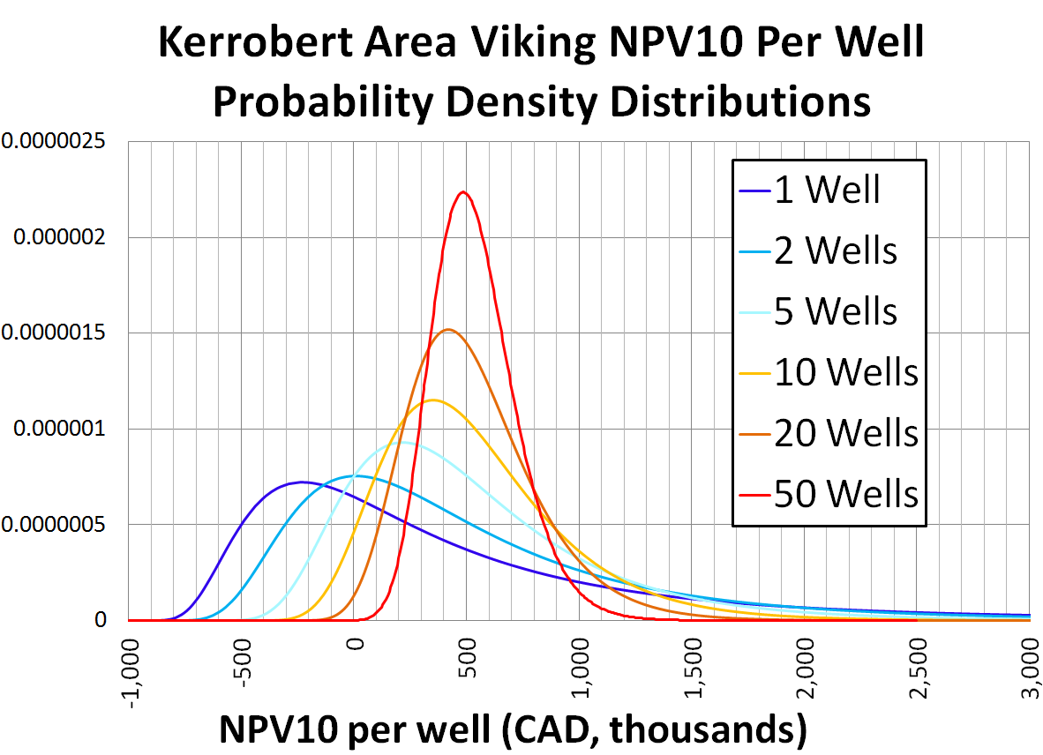
Expectations tighten with more wells
# Wells | P50
1 | $137k
2 | $308k
5 | $405k
10 | $478k
20 | $497k
50 | $523k
Here, every well drilled is geostatistically independent from every other well (“shotgun blast” scenario)

Slide 26
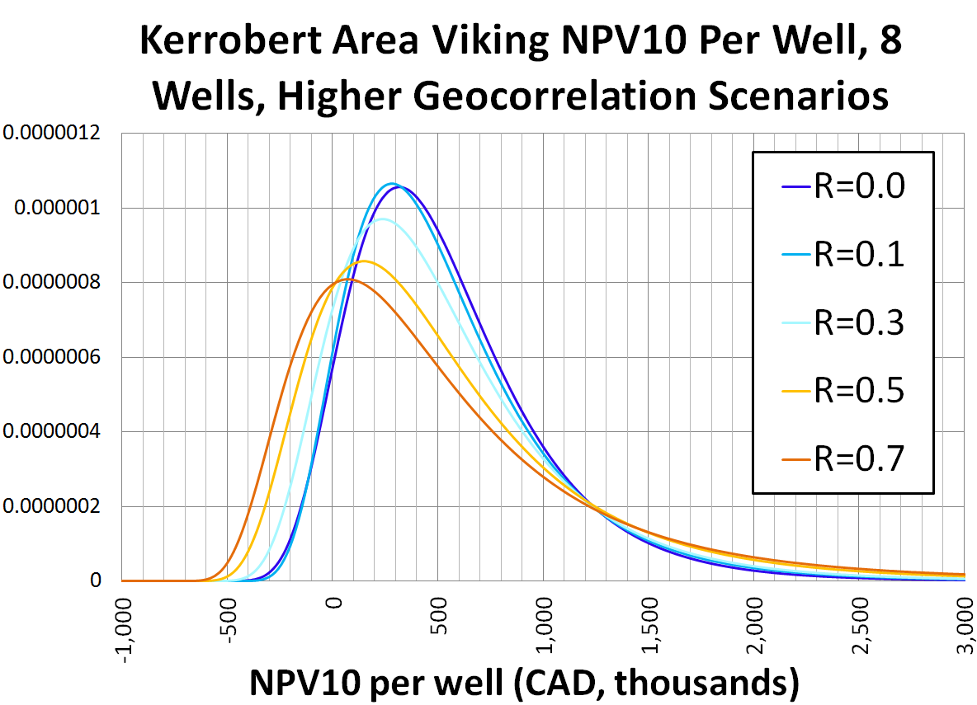
Expectations don’t tighten as much if wells are all drilled in one small area
R=0.0 P50: $459k
R=0.1 P50: $454k
R=0.3 P50: $425k
R=0.5 P50: $393k
R=0.7 P50: $345k
If 8 wells are all drilled in the same section, then some of the “law of averages” effect is lost
Kerrobert within one mile

Slide 27
4) Real Options Analysis
In designing gas processing plants an important factor is the degree to which various higher weight hydrocarbons are separated from methane. This is commonly done by chilling the gas until the higher weight hydrocarbons condense and can be removed as a liquid. This allows the higher weight hydrocarbons to be sold as liquids (taking advantage of higher liquids prices) instead of a gas. However, running gas plants at lower temperatures increases capital and operating costs.
The choice of plant operating temperature can be viewed as a real option. The value of this real option will be determined by whether various hydrocarbon species (ethane, propane, butane, pentane, etc.) are sold as separate liquids or sold within the gas stream, by the incremental cost of constructing plants capable of operating at lower temperatures and by the incremental costs of operating at those lower temperatures. As the prices of various hydrocarbon species are interdependent (and likely co-integrated), a suitable commodity price model will likely be needed.
A successful solution would propose an analytical model that captures the major physical relationships between liquid yield, operating temperatures and operating cost; inclusion of a simplified co-integrated price model; calculation of the optional value of plant construction as a function of input parameters, including temperature and any computer code required for these calculations.
Historical data for various hydrocarbon prices series can be provided by GLJ Publications, simplified models for hydrocarbon yields and plant costs can be provided by GLJ Petroleum Consultants.

Slide 28
Hydrocarbon Prices are related, likely Co-Integrated

Slide 29
Price Response to Drilling
As the scale of the gas resource became clear, gas became relatively cheaper and liquids became more valuable
Industry responded by drilling more wells in liquid rich regions bringing on more liquids and returning the price ratio to something more moderate

Slide 30
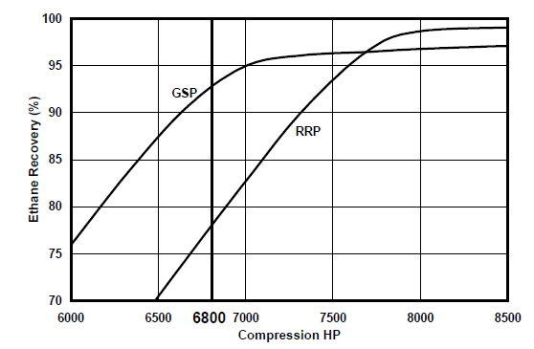
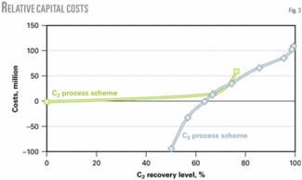
More Liquids Recovery Generally Requires More Energy
$2K/HP is a commonly used factor for capital cost. If the power is provided by natural gas, the operating cost directly tied to the cost of gas. If the compressors are electrically driven, the cost is directly tied to the cost of power: $0.08 to $0.28/kWh, or more.
As a result, costs increase as liquid recoveries increase.
https://www.ogj.com/articles/print/volume-103/issue-32/processing/study-identifies-optimal-csub2-sub-recovery-for-ngl-plants.html

Slide 31
Thank You
Michael Morgan
Director, Analytics
Phone: +1-403-266-9437 Fax: +1-403-262-1855
Email: mmorgan@gljpc.com
GLJ Petroleum Consultants Ltd. 4100, 400 - 3rd Ave. S.W. Calgary, Alberta, Canada T2P 4H2

